Slide 1

Including Emotion & Sentiment in Multimodal Learning with Audio and Transcripts of Earnings Conference Calls for Predicting Volatility of Stock Prices
James Chapman, Nathan Diehl, and John Woods
CIS 831 Deep Learning – Term Project
Kansas State University
jameschapman@ksu.edu, npdiehl@ksu.edu, jwoods03@ksu.edu

Slide 2
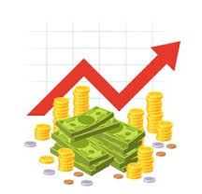
Overview
Introduction
Related Work
The Data
Text Embeddings
Audio Embeddings
Transformer Model & Training
Results
Discussion/Conclusion

Slide 3
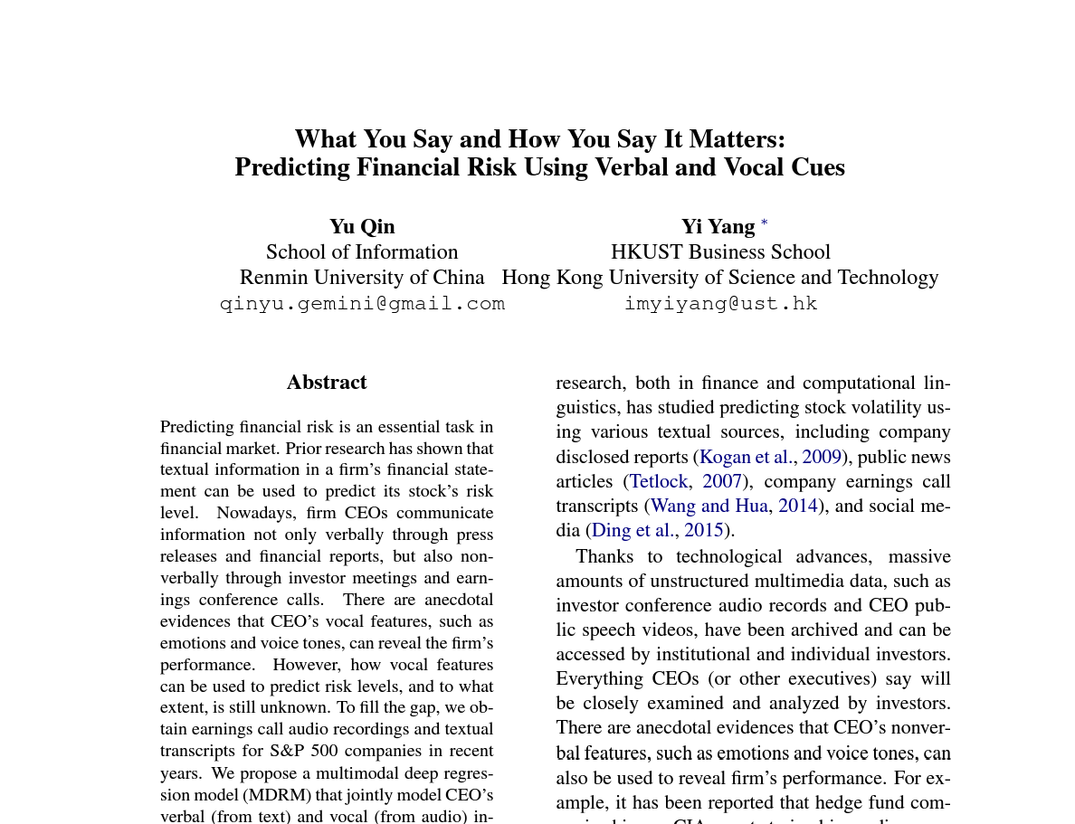
Introduction
What You Say and How You Say It Matters (Qin & Yang 2019)
First to use both text and audio for predictions
Earnings Conference Calls
Fortune 1500s
CEOs/CFOs
Voice and Emotion is useful for predicting stock price volatility

Slide 4
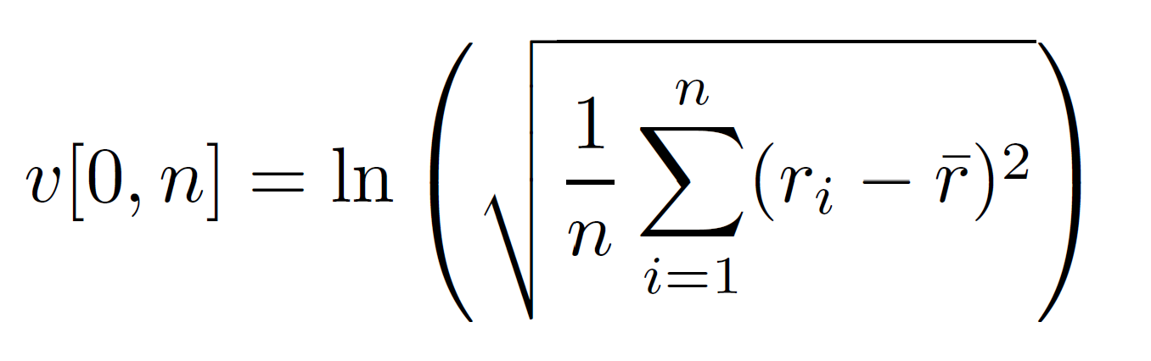
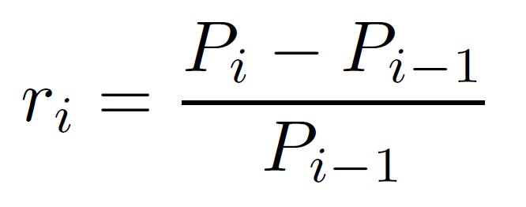
Introduction
Predicting Volatility
Stability of Stock Price
Risk Management
4 Intervals After Meeting
3 days
7 days
15 days
30 days
where
P_{i} is the adjusted closing price of a stock on day i

Slide 5
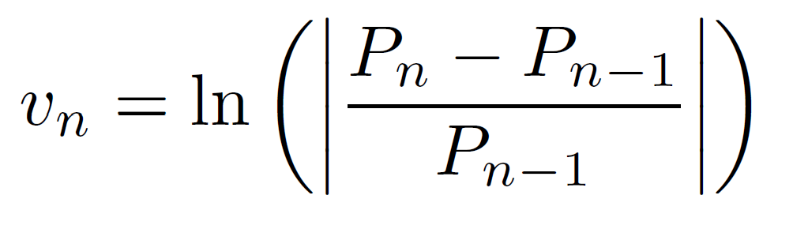
Introduction
Multi-Task Learning
Secondary target
Log percent change of last day in the interval
Used only in training/backpropagation
Improves Generalization & Stability

Slide 6
Related Work
Much research has been done into predicting stock prices from transcripts of earnings calls
Relevant Follow-up Papers to Qin & Yang (2019)
MAEC (Li et al. 2020)
Provides new dataset with meetings from 2015, 2016, & 2017
HTML (Yang et al. 2020)
Combines text and audio data to create far more accurate predictions for both short and long term
KeFVP (Niu et al. 2023)
Injects knowledge of financial metrics to aid in text comprehension
Also provides stock volatility targets

Slide 7
Data
2 Datasets
Original (Qin & Yang 2019) - 572 meetings
MAEC (Li et al. 2020) - 3443 meetings
Each meeting – at most 500 sentences (zero padding)
Each sentence
Text Transcript + Audio Recording
Text embedding + Audio embedding
Match each text sentence to section of audio

Slide 8
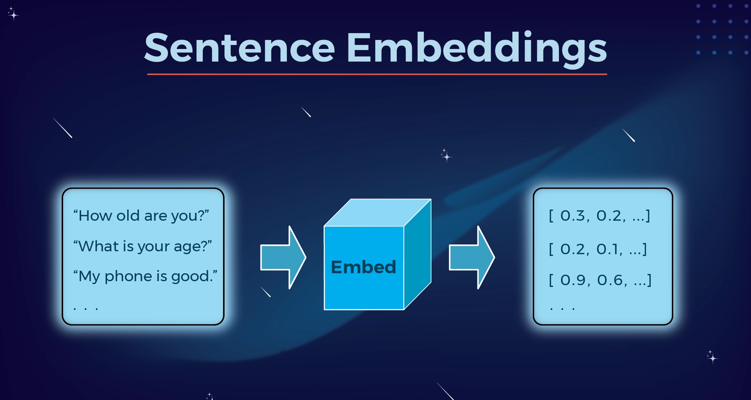
Text Embeddings
GloVe
RoBERTa
SentenceTransformer
OpenAI GPT-4o mini

Slide 9
Text Embeddings
GloVe - Static Word Embeddings
Each word -> vector of 300
Average word vectors in each sentence
RoBERTa (FacebookAI) – Contextual Word Embeddings
Tokenizer + Model
Each word -> vector of 1024
Average last layer of hidden states in each sentence

Slide 10
Text Embeddings
SentenceTransformer (HuggingFace)
FinLang/finance-embeddings-investopedia
haophancs/bge-m3-financial-matryoshka
philschmid/bge-base-financial-matryoshka
Motivation
Sentence specific models
Pre-trained on financial data sets
No improvement on Roberta

Slide 11
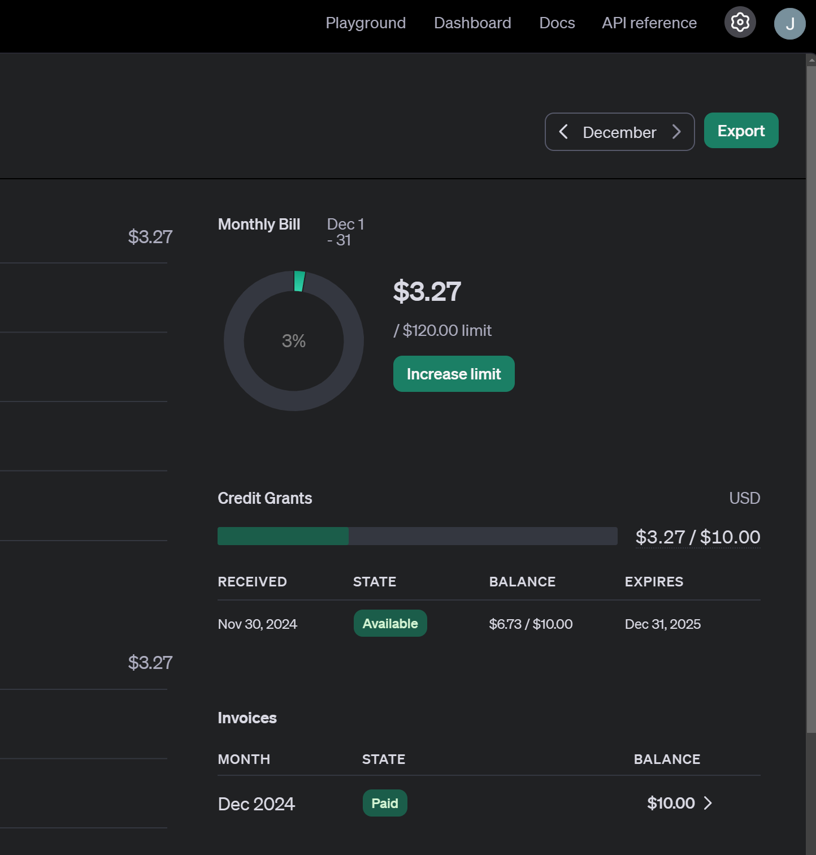
Text Embeddings
OpenAI - Sentiment Classification
Used the GPT-4o mini model
Python API
10 sentiments
One hot encoding
Allows multiple sentiments per sentence
Very slow (still processing MAEC data)
Limited by OpenAI API throttling

Slide 12
Text Embeddings
prompt = """
Context:
You are a financial sentiment analyst. Your task is to analyze a sentence from an earnings conference call and classify it across ten sentiment categories. Each category is binary: assign a value of 1 if the category applies to the sentence and 0 otherwise.
Sentiment Categories:
1. Positive Outlook: Optimism about performance or growth potential.
2. Negative Outlook: Indications of risk, concern, or underperformance.
3. Neutral/Factual: Purely informational with no evaluative tone.
4. Cautiously Optimistic: Optimism balanced with acknowledgment of risks.
5. Concerned/Uncertain: Expressions of doubt or lack of clarity about the future.
6. Strong/Confident: Decisive language indicating leadership or control.
7. Weak/Insecure: Hesitant or non-committal tone suggesting insecurity.
8. Growth-Oriented: Focused on expansion, opportunities, or investments.
9. Cost-Conscious: Emphasis on cost management, efficiency, or budgeting.
10. Risk-Acknowledging: Recognition of challenges or uncertainties.
Instructions:
1. Evaluate each category independently.
2. Return only a list of 10 numbers (0 or 1), corresponding to the categories above, in order.
3. If a sentence applies to multiple categories (e.g., optimism and risk acknowledgment), assign 1 to all applicable categories.
Input Sentence:
{}
Output Format:
[List of 10 numbers]
"""

Slide 13
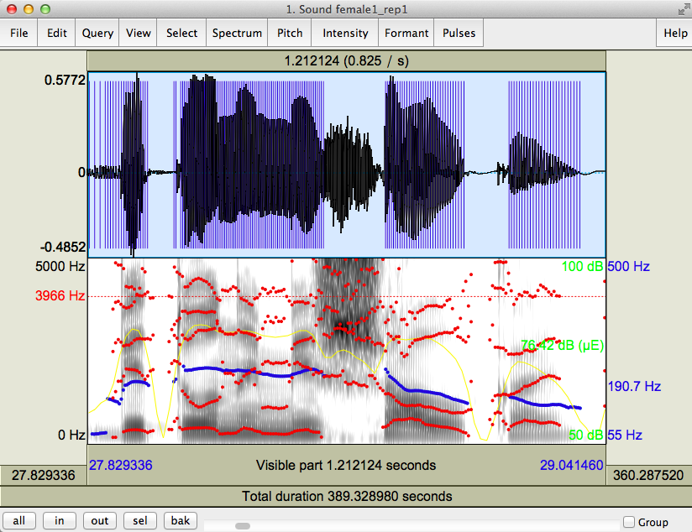
Audio Embeddings
Praat
emotion2vec

Slide 14
Audio Embeddings
Praat
Speech analysis software
Allows for speech analysis, synthesis, generation, labelling, grammar modelling, and statistical analysis
Generates 27 features
Pitch Mean Pitch Standard deviation Pitch Minimum Pitch Maximum Number of pulses Number of periods Mean period Mean intensity Minimum intensity Maximum intensity Standard deviation of period Fraction of unvoiced Number of voice breaks Degree of voice breaks
Jitter local Jitter local absolute Jitter rap Jitter ppq5 Jitter ddp Shimmer local Shimmer local dB Shimmer apq3 Shimmer apq5 Shimmer apq11 Shimmer dda Mean autocorrelation Mean NHR Mean HNR Audio Length

Slide 15

Audio Embeddings
emotion2vec
Speech emotion recognition model
First of its kind
Self-supervised model trained on unlabeled emotion data
Outputs probability distribution of 9 emotions
Angry | Surprised
Disgusted | Neutral
Fearful | Other
Happy | Unknown
Sad

Slide 16
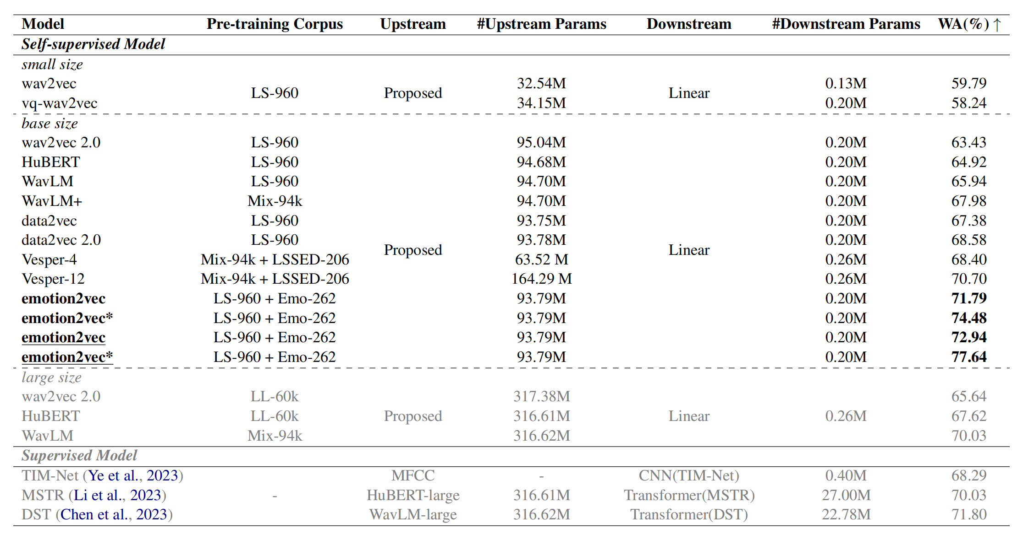
Audio Embeddings
Current state-of-the-art (IEMOCAP)
The Interactive Emotional Dyadic Motion Capture Database
Videos of actors in conversation for each of the 9 emotions

Slide 17
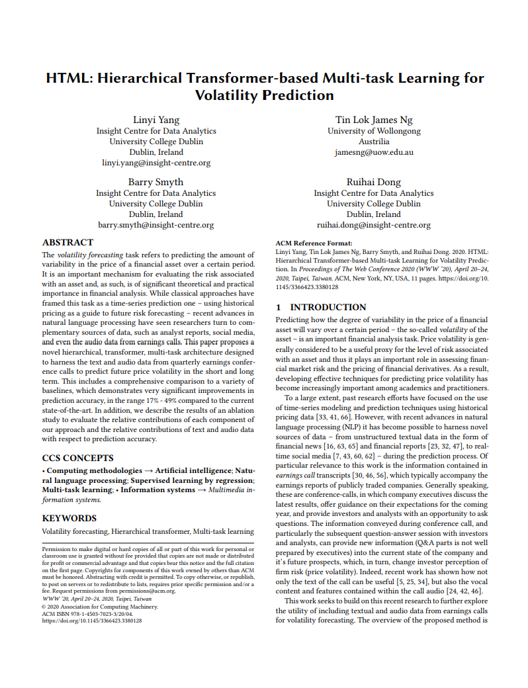
Transformer Model
HTML (Yang et al. 2020)
“Attention is all you need”
Hierarchical
Transformer-based
Multi-task
Learning

Slide 18
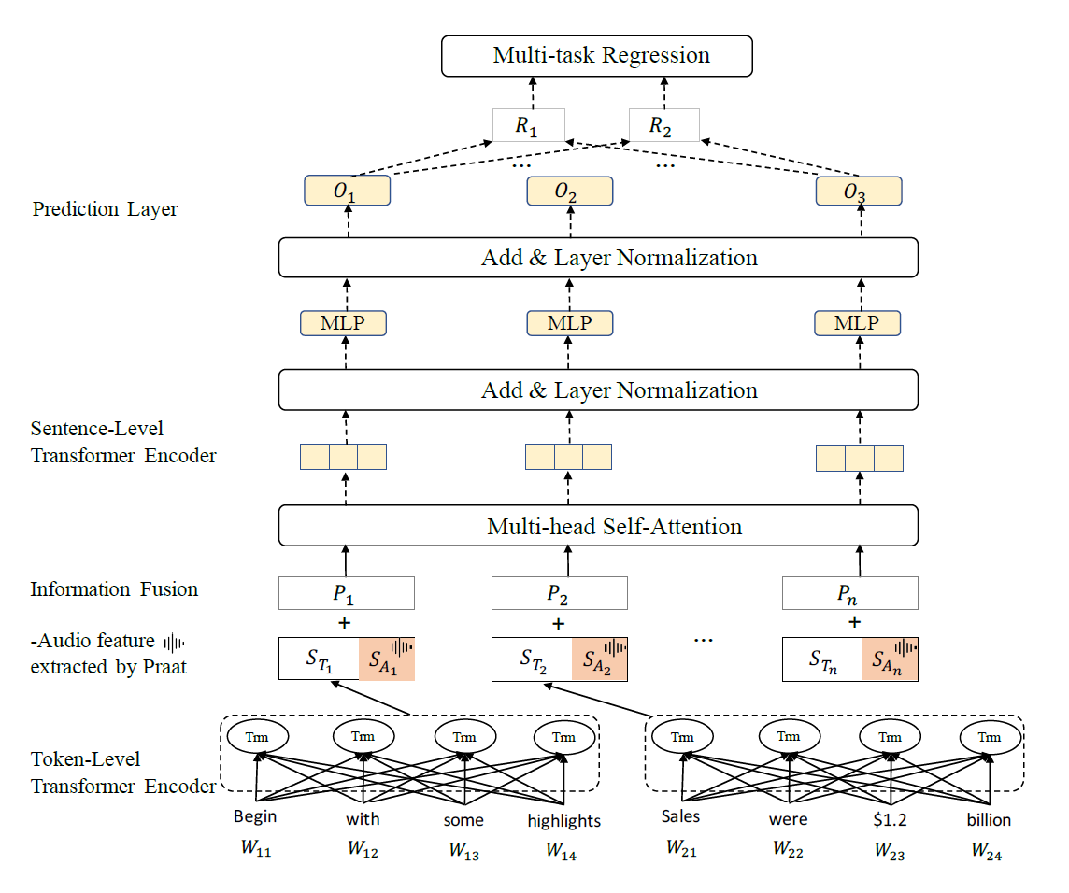
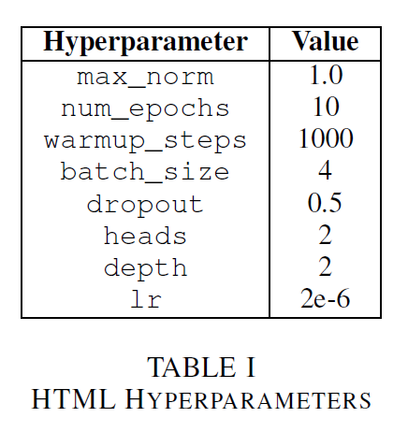
Transformer Model
Model on GitHub
PyTorch-based

Slide 19
Transformer Model
(Single Meeting)
Text
Embeddings
(ex: RoBERTa= 1024)
MP3 Audio
Embeddings
(ex: Praat= 27)
 | 1 | 2 | 3 |  | 1024 | 1025 | 1026 |  | 1051
1 | float32 | float32 | float32 | … | float32 | float32 | float32 | … | float32
2 | float32 | float32 | float32 | … | float32 | float32 | float32 | … | float32
3 | float32 | float32 | float32 | … | float32 | float32 | float32 | … | float32
4 | float32 | float32 | float32 | … | float32 | float32 | float32 | … | float32
 | … | … | … | … | … | … | … | … | …
497 | float32 | float32 | float32 | … | float32 | float32 | float32 | … | float32
498 | float32 | float32 | float32 | … | float32 | float32 | float32 | … | float32
499 | 0 | 0 | 0 | … | 0 | 0 | 0 | … | 0
500 | 0 | 0 | 0 | … | 0 | 0 | 0 | … | 0
Sentences
(Zero padding)

Slide 20
Transformer Model
(Single Meeting)
Text
Embeddings
(ex: RoBERTa= 1024)
MP3 Audio
Embeddings
(ex: Praat= 27)
 | 1 | 2 | 3 |  | 1024 | 1025 | 1026 |  | 1051
1 | float32 | float32 | float32 | … | float32 | float32 | float32 | … | float32
2 | float32 | float32 | float32 | … | float32 | float32 | float32 | … | float32
3 | float32 | float32 | float32 | … | float32 | float32 | float32 | … | float32
4 | float32 | float32 | float32 | … | float32 | float32 | float32 | … | float32
 | … | … | … | … | … | … | … | … | …
497 | float32 | float32 | float32 | … | float32 | float32 | float32 | … | float32
498 | float32 | float32 | float32 | … | float32 | float32 | float32 | … | float32
499 | 0 | 0 | 0 | … | 0 | 0 | 0 | … | 0
500 | 0 | 0 | 0 | … | 0 | 0 | 0 | … | 0
Volatility
Sentences
(Zero padding)

Slide 21
Transformer Model
Training
Tune: Alpha hyper-parameter
Multi-task loss function
Train/Validation/Test splits from paper
Standard scaler
Recombine training/validation sets
$$\text{Loss}\text{=}\text{α}\text{⋅}\text{MSE}\text{(}\text{Volatility}\text{)​+(1−}\text{α}\text{)⋅}\text{MSE}\text{(}\text{Secondary} \text{Target}\text{)}$$

Slide 22
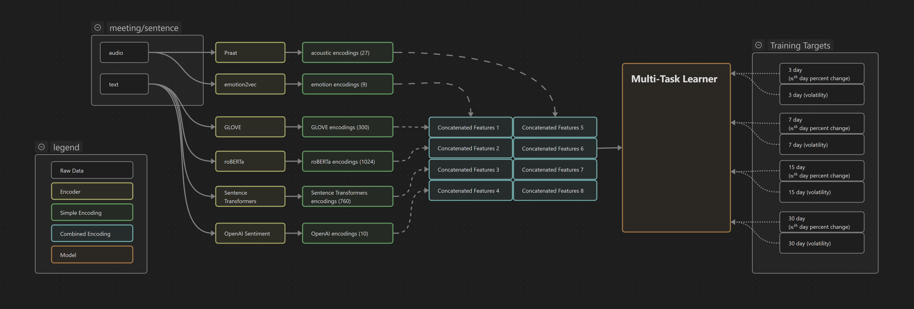
High Level Architecture

Slide 23
Results
~4000 meetings with ~500 sentences
15 embedding method combinations
5 Text embedding methods
2 Audio embedding methods
With/without OpenAI sentiment embeddings
4 Targets (3 days, 7 days, 15 days, 30 days)
3 years (2015, 2016, 2017)
180 models trained and tested

Slide 24
Results

Slide 25
Discussion & Conclusion
Challenges
Target data issues
Dividend Adjusted Closing Prices
Missing stock price volatility for certain stocks
Emailed KeFVP authors (gave MP3 data but not stock price volatility)
Beocat maintenance
Made it difficult to run our experiments

Slide 26
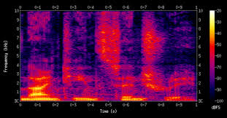
Discussion & Conclusion
Future Work
Spectrogram 2D image of audio
Convolutional neural network
Experiment with prompting
Leverage LLMs for more advanced reasoning
Send transcripts, ask ChatGPT questions about it
Retrieval Augmented Generation
Other research has found success with this
Incorporate news articles about companies
Price movement instead of volatility

Slide 27
Discussion & Conclusion
Summary and Conclusions
Used multimodal learning to predict stock price volatility from earnings call transcripts and recordings
Tested different combinations of audio and text embeddings with the HTML model
Applied pre-trained emotion2vec model to extract sentiment from audio
Applied OpenAI GPT-4o mini LLM to extract sentiment data from transcripts
Tested against 3, 7, 15, and 30 day volatility targets to test model performance in short and long timeframes
Found that RoBERTa and BGE text embeddings with Praat audio embeddings result in the best model performance across much of the data
Still running experiments for MAEC and sentiment analysis

Slide 28
References
Y. Qin and Y. Yang, “What you say and how you say it matters: Predicting stock volatility using verbal and vocal cues,” in Proceedings of the 57th Annual Meeting of the Association for Computational Linguistics (A. Korhonen, D. Traum, and L. M`arquez, eds.), (Florence, Italy), pp. 390–401, Association for Computational Linguistics, July 2019.
J. Li, L. Yang, B. Smyth, and R. Dong, “MAEC: A multimodal aligned earnings conference call dataset for financial risk prediction,” in Proceedings of the 29th ACM International Conference on Information & Knowledge Management, CIKM ’20, (New York, NY, USA), p. 3063–3070, Association for Computing Machinery, 2020.
L. Yang, T. L. J. Ng, B. Smyth, and R. Dong, “HTML: Hierarchical transformer-based multi-task learning for volatility prediction,” in Proceedings of The Web Conference 2020, WWW ’20, ACM, Apr. 2020.
H. Niu, Y. Xiong, X. Wang, W. Yu, Y. Zhang, and W. Yang, “KeFVP: Knowledge-enhanced financial volatility prediction,” in Findings of the Association for Computational Linguistics: EMNLP 2023 (H. Bouamor, J. Pino, and K. Bali, eds.), (Singapore), pp. 11499–11513, Association for Computational Linguistics, Dec. 2023.

